Slide 1
Taxonomies - EIOPA
SII v2.4
Production version released the 15th of July
Not many changes from 2.3
Controls are more documented
Error messages harmonized
Arithmetic interval indicated
Default values explained
V2.4.0 hotfix should not be necessary

Slide 2
Taxonomies - EIOPA
SII v2.4
Brexit
Introduction of new members in GA domain
Difference is the presence in Europe hierarchies or not
New « After Brexit » members are not usable by defaults, controls will be removed when applicable
In 2.5, « After Brexit » members will lose this label and older members will gain label « Before Brexit)
Label | Name | Default | Owner | Creation date
UNITED KINGDOM (GIBRALTAR) | GI |  | s2c | 07/07/2014
UNITED KINGDOM | GB |  | s2c | 07/07/2014
UNITED KINGDOM (AFTER BREXIT) | x115 |  | s2c | 15/07/2019
UNITED KINGDOM (GIBRALTAR) (AFTER BREXIT) | x116 |  | s2c | 15/07/2019

Slide 3
Taxonomies - EIOPA
SII v2.5
Taxonomy evolution as usual
SII v2.6
Technical changes due to the « Big Review 2020 ». Consultation will begin during this fall
Validation mechanism will evolve
An open template will be introduced to add comment explaining why a « warning » control is triggered
Severity of control will be modified during lifecycle
The taxonomy will be named « 2021.1 » and not « 2.6 »

Slide 4
Taxonomies - EBA
v2.9
Modulary releases

Slide 5
Taxonomies - EBA
v2.9
Known errors
The type of metric pi554 decimalItemType
Will be modified in percentItemType in 3.0
Non-greyed cells at C72.00 a and w
Typographic errors in labels
Inconsistencies between ITS and DPM
For exemple, R0060 et R0100 pour C107.01
Erroneous controls
Deactivation list published : 10 september
Other problems, cf Q&A EBA

Slide 6
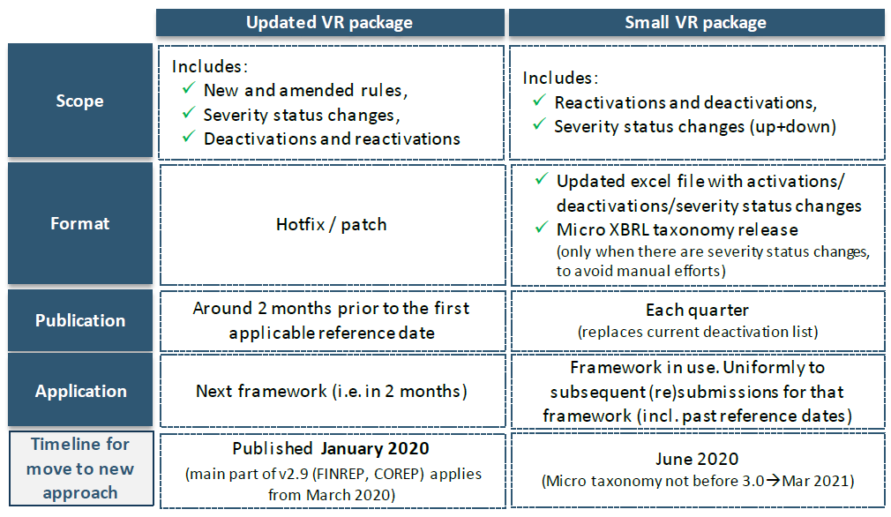
Taxonomies - EBA
v2.9
Quality : Increase in the frequency of taxonomy patches

Slide 7
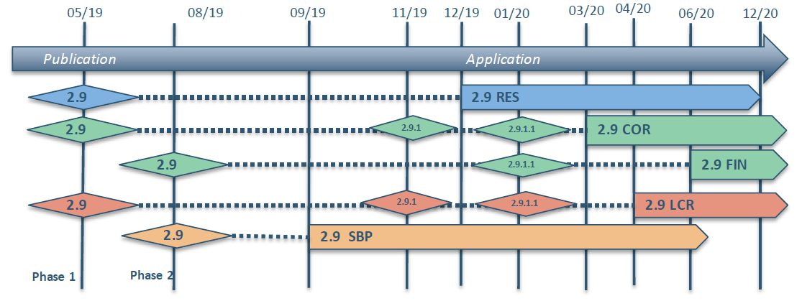
Taxonomies - EBA
v2.9
Quality : Increase in the frequency of taxonomy patches
2.9.1 : Corrective release for Corep and LCR
Datapoints not compatible !
2.9.1.1 : « Updated VR Package »
Some controls will be added / modified

Slide 8
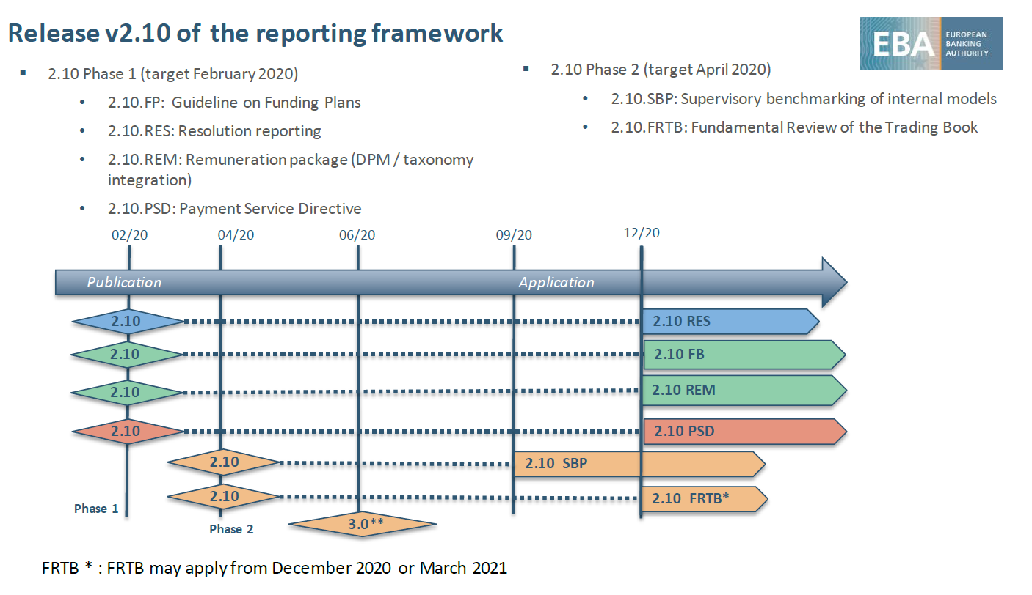
Taxonomies - EBA
v2.10
Excluding Corep/Finrep frameworks

Slide 9
Taxonomies - EBA
v3.0
Reglementary modifications
CRR2
BRRD2
Technical modifications
Consolidation indication
Modification for liquidity subgroups (from 2.10)
May be extended to other consolidations in the futures
Facilitation modification of controls during the lifetime of the taxonomy
Modification of the file structure of the controls
Be ready for larger, more granular data collection
Introduction of XBRL OIM/CSV ou OIM/Json on instance level ? (v3.0+)

