Slide 1
Bank & Insurance Working Group
Thomas Verdin
Tesh Advice
Vincent Le Moal-Joubel
Banque de France
08/04/2021

Slide 2
Taxonomies - EIOPA
SII v2.4
Taxonomy 2.5
Production version released on July 15
Hotfix released on November 3
Last modification of deactivated assertions list : 8th March 2021
Now
2021/08/04

Slide 3
Taxonomies - EIOPA
SII v2.5 Hotfix
No datapoint modified
78 assertions modified (no new, no deleted assertions since v2.5)
IORP v2.5 Hotfix
No datapoint modified
20 assertions modified (no new, no deleted assertions since v2.5)
2021/08/04

Slide 4
Taxonomies - EIOPA
Brexit
Before and After UK members in GA domain
New « After Brexit » members will be used from reporting dates > 2020/12/31
4 assertions (TV71, TV72, TV73, TV74) are conditioned by reporting date to control the basic use of these members
Label | Name | Default | Owner | Creation date
UNITED KINGDOM (GIBRALTAR) | GI |  | s2c | 07/07/2014
UNITED KINGDOM | GB |  | s2c | 07/07/2014
UNITED KINGDOM (AFTER BREXIT) | x115 |  | s2c | 15/07/2019
UNITED KINGDOM (GIBRALTAR) (AFTER BREXIT) | x116 |  | s2c | 15/07/2019
2021/08/04

Slide 5
Taxonomies - EIOPA
Brexit
2 exceptions :
To report the duration period of one year for monetary figures
One value as for the UNITED KINGDOM (e.g. 10 months)
One value as for the UNITED KINGDOM (AFTER BREXIT) (e.g. 2 months)
2021/08/04

Slide 6
Taxonomies - EIOPA
Brexit
2 exceptions :
For closed tables, where UNITED KINGDOM is an explicit annotation of given row or column, it will continue to be used in 2.5 after BREXIT
2021/08/04

Slide 7
Taxonomies - EIOPA
SII v2.6
Validation mechanism will evolve
An open template will be introduced to add comment explaining why a « warning » control is triggered
Severity of control will be modified during lifecycle, like EBA
New proposed taxonomy lifecycle
July 15 Full taxonomy
June 1 Taxonomy without assertions
November 1 Correction of non-working assertions (aka « Hotfix » today)
Q4 Y-1 / Q1 Y Two draft taxonomies (PWD)
2021/08/04

Slide 8
Taxonomies - EIOPA
PEPP reporting
Agenda
Publication of Regulation: 25 July 2019
Deadline for EIOPA to deliver ITS: 14 August 2020
PEP KID Taxonomy : publication by end of February 2021
First PWD : 3 March 2021
PEP Taxonomy : publication in July 2022 (alongside SII 2.7)
Implementation
Standalone framework or included in SII : not decided yet
2021/08/04
Notes:
Pan European Pension Product

Slide 9
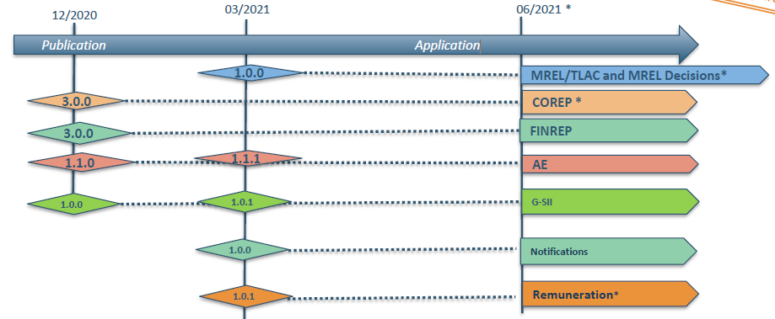
Taxonomies - EBA
Taxonomy 3.0
2021/08/04
Notes:
3.0 Notifications: a new framework
1.To notify liabilities subject to impracticability
2.Sent from Institutions to RAs
3.EBA has no intention to collect it yet
4.No frequency, can be sent any day
5.Individual data
A new framework with one module GSII indicators (Global Systemically Important Institutions):
One template G 01.00
Reporting frequency: quarterly
The first reference date: 2021-06-30
Reported by institutions, and will be collected by the EBA using sequential approach.

Slide 10
Taxonomies - EBA
Taxonomy 3.0
2 phases
Phase 1 : published in January
Phase 2 : MREL/TLAC, REM : Published in March
2021/08/04

Slide 11
Taxonomies - EBA
v3.0 Reglementary modifications
CRR2
BRRD2
Technical modifications
Flexible way to change severity of assertion during taxonomy lifecycle
Modification of the file structure of the controls
Number of digits in DPM coordinates (row, columns, Z) increased to 4
Metric pi445 (introduced in V2.8) has been fixed from decimalItempType to percentItemType in V3.0
More than 100 duplicated validations have been deleted
2021/08/04

Slide 12
Taxonomies - EBA
Taxonomy 3.0
Phase 2 Errata : Published today (8th April)
On taxonomy:
Amend m_02.00.a.xsd and m_02.00.a-def.xml to reflect the grey cells on M 02.00.a
Amend 4 table label files to precise the label of open dimensions on z axis:
▪ r_04.00.a-lab-en.xml
▪ r_04.00.b-lab-en.xml
▪ r_04.00.c-lab-en.xml
▪ c_08.05.1.b-lab-en.xml
Amend tax-lab-en.xml for taxonomy FINREP IND to use the correct version number 3.0.0
2021/08/04

Slide 13
Taxonomies - EBA
Taxonomy 3.0
Phase 2 Errata : Published today (8th March)
On DPM :
Update XbrlTableCode for table M 02.00.a in TableVersion
update TableVersion set XbrlTableCode = "M_02.00.a" where TableVID = 2028;
Update TaxonomyLabel for FINREP3.0-Ind
Update Taxonomy set TaxonomyLabel ='FINancial REPorting 3.0.0 Individual (DPM 3.0)' where TaxonomyID = 66;
Update CodeDomainID for Metric 9208
update Metric set CodeDomainID = 130 where MetricID = 9208;
2021/08/04

Slide 14
Taxonomies - EBA
V3.1
New reporting (Q1 2021)
Invest Firms
Updated reporting (Q2 2021)
Resolution
SBP
Introduction of xBRL-CSV : necessary metadata json files in taxonomy for the the new reporting included
2021/08/04

Slide 15
Taxonomies - EBA
V3.2 (under discussion)
IRRBB (Interest Rate Risk in the Banking Book)
IRB Reporting (Internal Ratings Based)
ALMM
RES
SBP
Maybe technical fixes for other entrypoints
2021/08/04

Slide 16
Taxonomies
Future of reporting : TFERF
OIM/xBRL-CSV has been published as Candidate Recommendation in October 2020, should be the last before Proposed Recommendation
Json metadata files will be introduced in EBA 3.1 taxonomy :
Directly in mod/ and tab/ directories
EIOPA taxonomy 2.7 should introduce json metadata files
Taxonomy Package should not evolve
Report package draft published early December 2020
2021/08/04

Slide 17
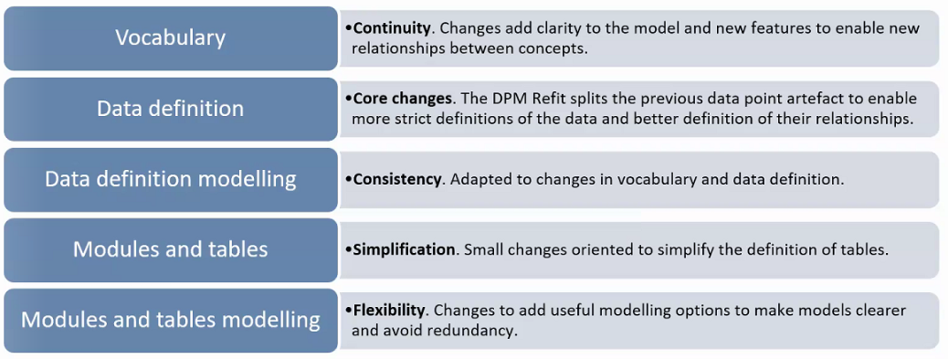
Taxonomies – EBA
DPM Refit
Update to the DPM methodology, first introduced nearly 10 years ago
Should be a smooth transition, without disruption
EBA/EIOPA joint effort
2021/08/04

Slide 18
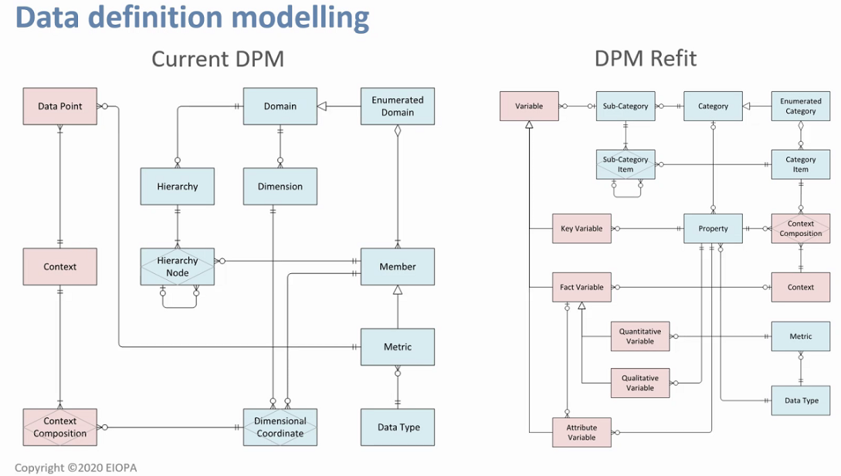
Taxonomies – EBA
DPM Refit
More detailed modelling
Open tables and links between tables will be clearly documented

Slide 19
Taxonomies – EBA
DPM Refit
Next steps
The project is still in discussion
Discussion will involve more and more members
Transition will be eased
Enough time to prepare to new DPM representation
Mappings between old and new DPM will be
Open questions
Date of availability
Impacts on the taxonomy
2021/08/04

